Slide 1

Task 1: YouTube Streamer Analysis
Karabo Kotli Diphoko
Notes:
Please read my notes as I will be explaining the results in the pictures

Slide 2
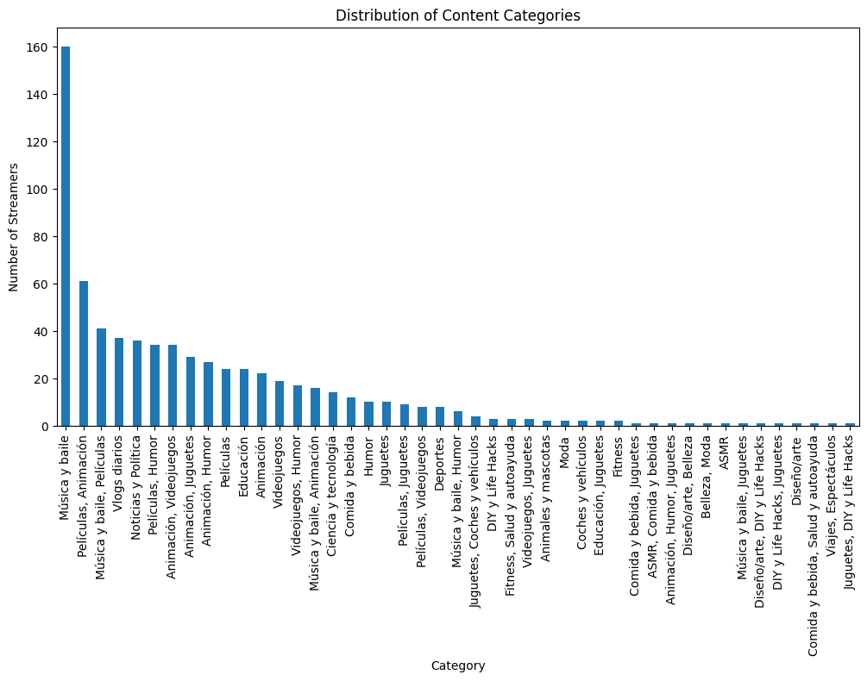
Notes:
The horizontal axis represents various content categories, ranging from “Mobile Video” to “Other.”
The vertical axis shows the number of items in each category.
The descending bar lengths indicate that “Mobile Video” has the highest number of items, while categories like “Digital Radio” and “Other” have fewer items
This chart could be useful for analyzing market trends, consumer behavior, or content popularity

Slide 3
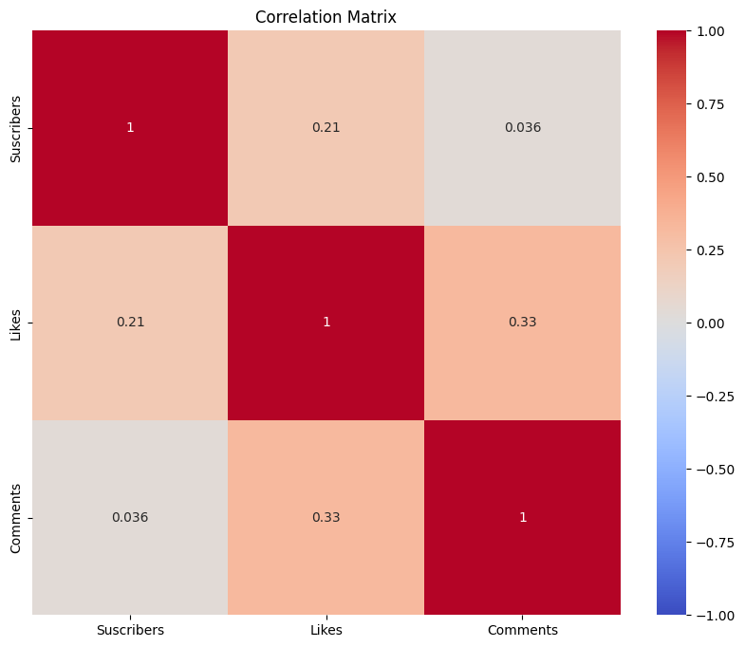
Notes:
The horizontal and vertical axes represent these three variables.
The color-coding ranges from dark red (strong negative correlation) to white (no correlation) to dark blue (strong positive correlation).
Each cell in the matrix contains a numerical value representing the correlation coefficient between two variables.
Here are some notable correlations:
Subscribers and Likes have a positive correlation of 0.21.
Subscribers and Comments have a weaker positive correlation of 0.036.
Likes and Comments have a stronger positive correlation of 0.33.
This matrix helps assess relationships between engagement metrics

Slide 4
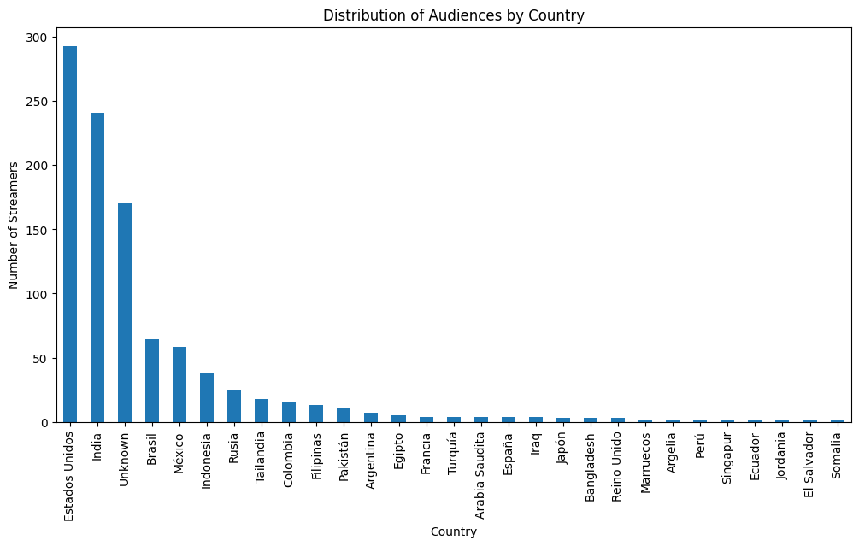
Notes:
The vertical axis represents the number of engagements, ranging from 0 to 300.
The horizontal axis lists various countries.
The country with the highest number of engagements is “Estados Unidos,” followed by a significant drop in engagements for the second country listed as “Brasil,” and decreasing further for subsequent countries.
This graph visually represents the distribution and disparity of audience engagement across different countries, highlighting which countries have more engaged audiences than others

Slide 5
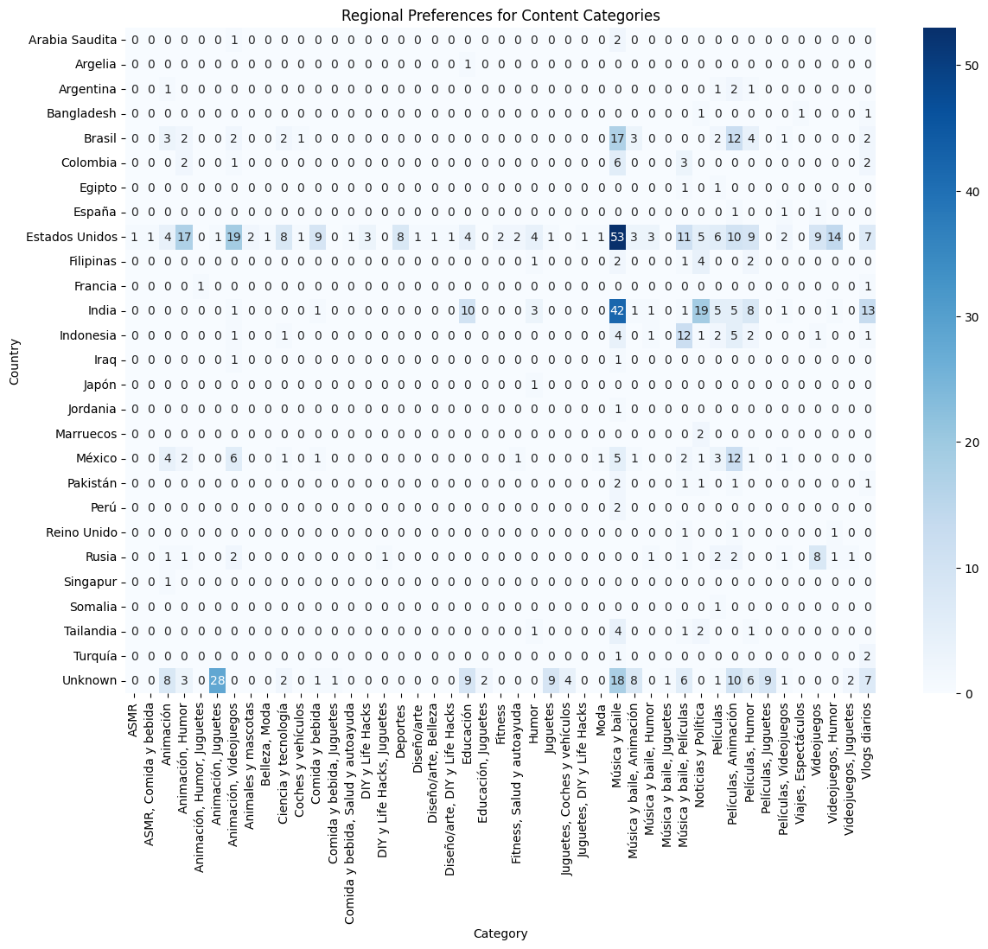
Notes:
The vertical axis lists various countries.
The horizontal axis represents different content categories.
Each cell within the matrix is shaded to indicate the level of preference, with a scale ranging from -5 to +5. Darker shades indicate stronger preferences.
This visualization provides insights into cultural and regional differences in content preferences across multiple countries and categories.

Slide 6
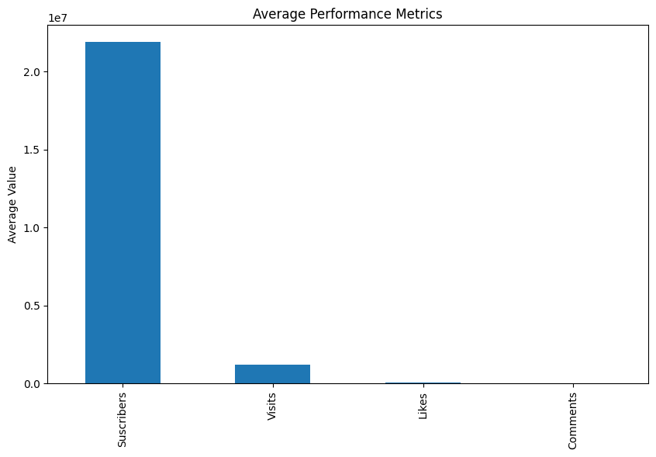
Notes:
The horizontal axis represents four categories: “Subscribers,” “Visits,” “Likes,” and “Comments.”
The vertical axis is labeled “Average Value” and ranges from 0 to 10 million (in scientific notation as 1e7).
The bar for “Subscribers” is significantly taller than the others, suggesting a high average value compared to “Visits,” “Likes,” and “Comments.”
This graph visually represents data that could be used to analyze the performance of a website or social media account.

Slide 7

Notes:
The graph displays various content categories on the horizontal axis.
The vertical axis represents the number of streamers, ranging from 0 to 160.
Notably, the category with the highest number of streamers is “Music,” followed by other categories like “IRL” and “Just Chatting.”
This graph visually represents data that could be used to analyze the popularity or prevalence of different streaming content categories.

Slide 8
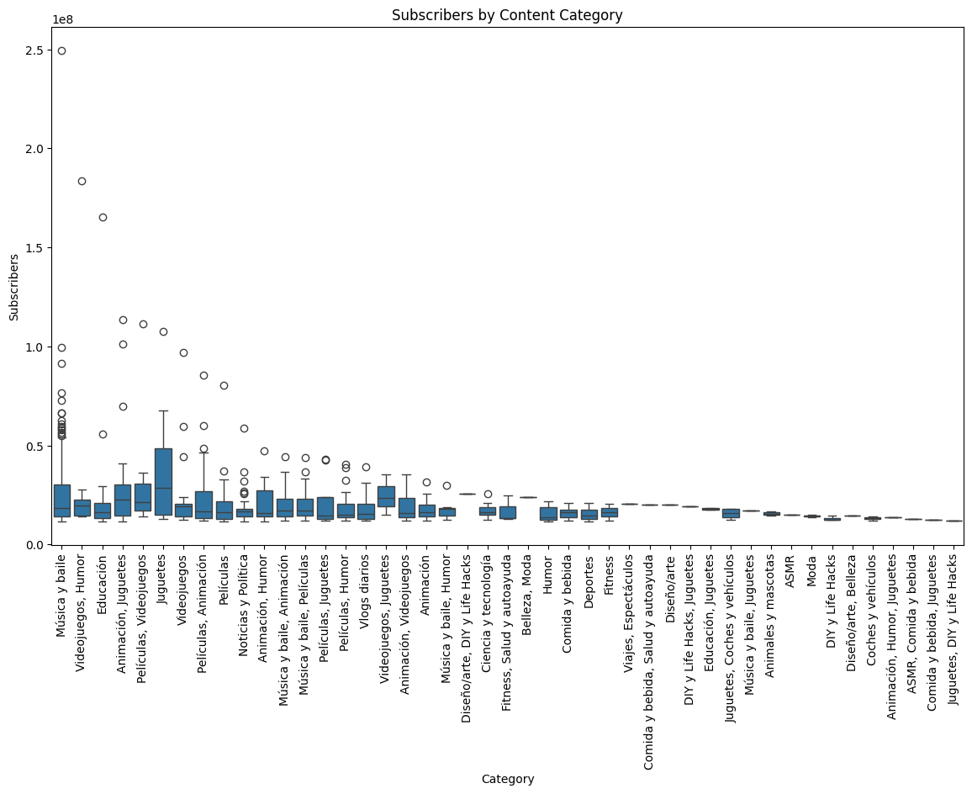
Notes:
The horizontal axis represents the number of “Subscribers,” ranging from 0 to 100 million (in scientific notation as 1e8).
The vertical axis represents the number of “Views,” ranging from 0 to 1.2 million (in scientific notation as 1.2e6).
Different colored dots represent various categories of streamers, such as “Education,” “Juegos,” “Películas,” “Música y baile,” “Vlogs diarios,” and “Diseñador y arte de uñas.”
The size of each dot correlates with the number of views; larger dots indicate more views.
This graph visually represents the relationship between the number of subscribers and views across different content categories on a streaming platform, highlighting top performers in each category.

Slide 9
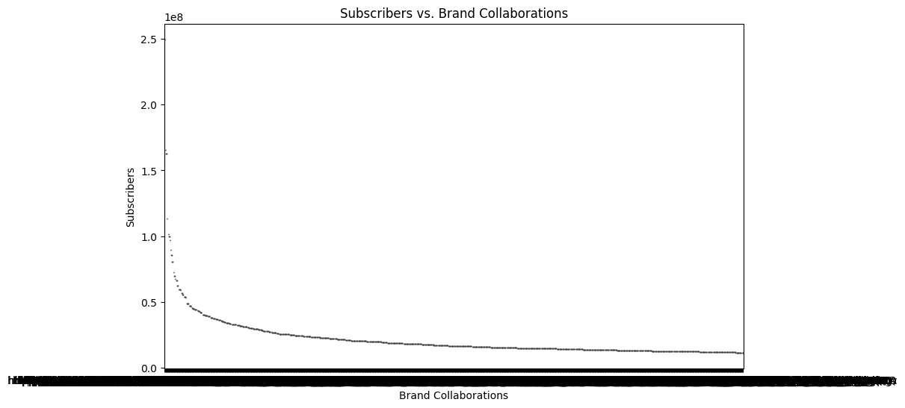
Notes:
The horizontal axis represents “Brand Collaborations.”
The vertical axis represents the number of “Subscribers,” ranging from 0 to 250 million (in scientific notation as 2.5e8).
The graph depicts a curve that starts high on the left and steeply declines towards the right, flattening out as it approaches the horizontal axis.
This suggests that as brand collaborations increase, the number of subscribers initially decreases sharply and then levels off.

Slide 10
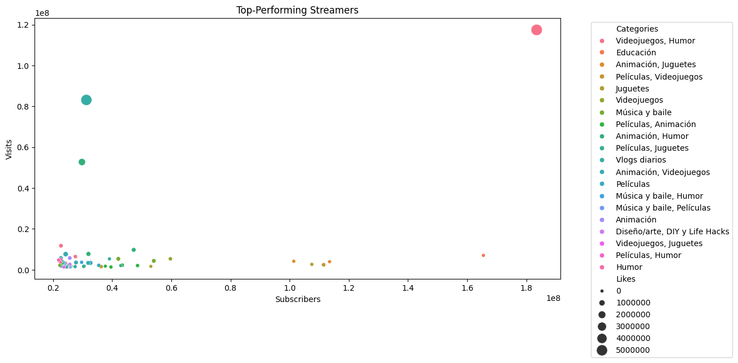
Notes:
The horizontal axis represents the number of “Subscribers,” ranging from 0 to 100 million (in scientific notation as 1e8).
The vertical axis represents the number of “Views,” ranging from 0 to 1.2 million (in scientific notation as 1.2e6).
Different colored dots represent various categories of streamers, such as “Education,” “Juegos,” “Películas,” “Música y baile,” “Vlogs diarios,” and “Diseñador y arte de uñas.”
The size of each dot correlates with the number of views; larger dots indicate more views.
This graph visually represents the relationship between the number of subscribers and views across different content categories on a streaming platform, highlighting top performers in each category.

Slide 11

Summary
Correlation Matrix: Visual representation of correlations between different variables (Subscribers, Likes, and Comments).
Distribution of Audiences by Country: Bar graph showing audience engagement across different countries.
Regional Content Preferences Heatmap: Heatmap indicating content category preferences in various countries.
Average Performance Metrics: Bar graph comparing average performance metrics across different categories.
Top-Performing Streamers: Scatter plot showing the relationship between subscribers and views for different content categories.
Subscribers vs. Brand Collaborations: Graph showing the relationship between subscribers and brand collaborations.
Subscribers by Content Category: Bar graph comparing subscriber counts across different content categories.
Subscribers vs. Views: Graph showing the relationship between subscribers and views for different content categories.
Subscribers by Content Category (Box Plot): Box plot showing the distribution of subscriber counts within content categories.

